Slide 1
ABC Call Volume Trend Analysis

Slide 2
PROJECT DESCRIPTION
This project focuses on Customer Experience (CX) analytics for an inbound calling team. The dataset covers a 23-day period and includes information such as agent ID and name, queue time, call time, call duration, and call status (abandoned, answered, or transferred). The objective is to analyze customer interactions to gain insights into customer experience and agent performance. The CX team plays a vital role in improving customer satisfaction by leveraging AI tools like IVR, RPA, and Predictive Analytics. The analysis aims to understand customer wait times, call outcomes, and the effectiveness of the inbound support process in fostering customer loyalty.

Slide 3
TECH-STACK USED
Microsoft Excel to analyze create pivot tables and charts, and to derive insights of the data.
Microsoft powerpoint to create the presentation of the process and insights of the project.

Slide 4




APPROACH
Analyzing the data provided
Extracting insights from the data
Creating charts to represent trends of the data
Presenting the results

Slide 5
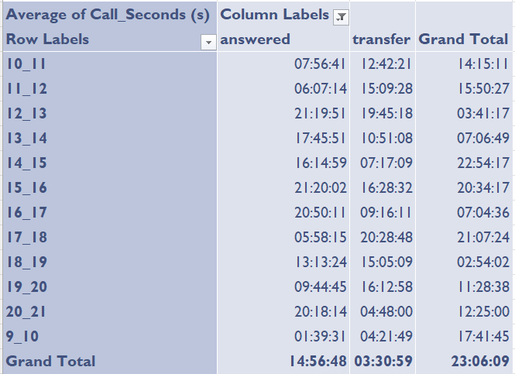
Average Call Duration:
What is the average duration of calls for each time bucket?
In Order to get the average duration of calls in each time bucket i have utilized the pivot table. In this i have used time bucket in rows and average of call seconds in values and also have considered the call status in columns to get separated values for both calls answered and transferred.
Created a line graph to represent the duration of calls answered and transferred for each time bucket.
Created a bar chart for total call seconds for each time bucket

Slide 6
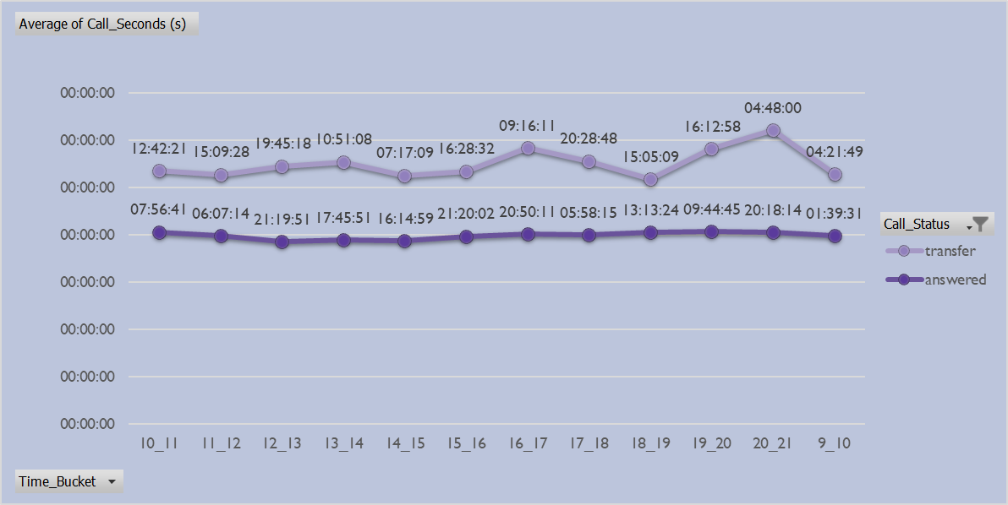
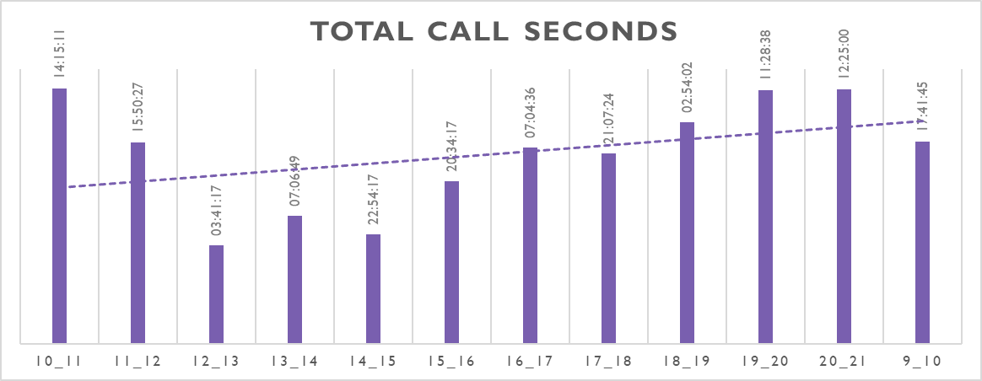
AVERAGE CALL SECONDS PER TIME BUCKET ON CALL STATUS
TOTAL CALL SECONDS PER BUCKET

Slide 7
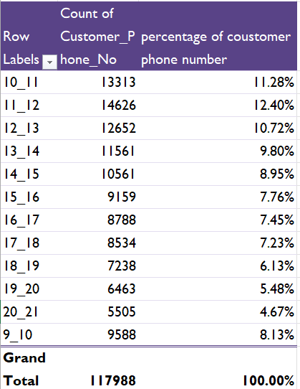
Call Volume Analysis
Can you create a chart or graph that shows the number of calls received in each time bucket?
To obtain the number of calls received in each bucket I have pivot table with time bucket in rows and count of customer phone number and percentage in values.
Created a graph for count of customer phone number and the percentage as per call buckets where count is represented in bars and the percentage in line

Slide 8
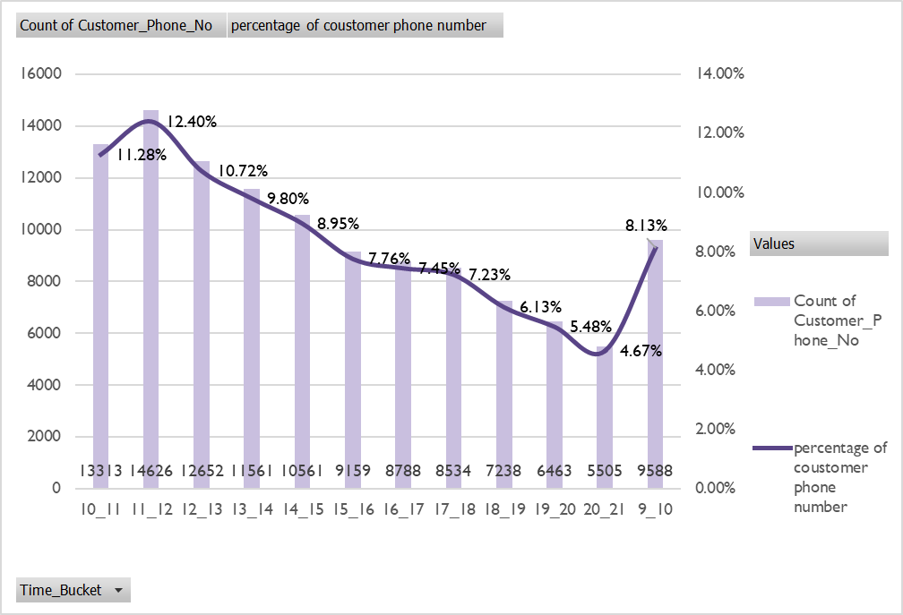
Count of customer phone number and there percentage in each time bucket

Slide 9
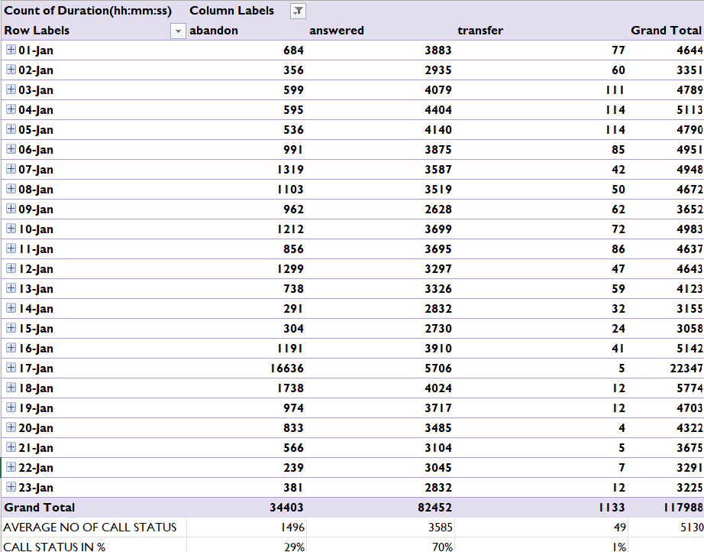
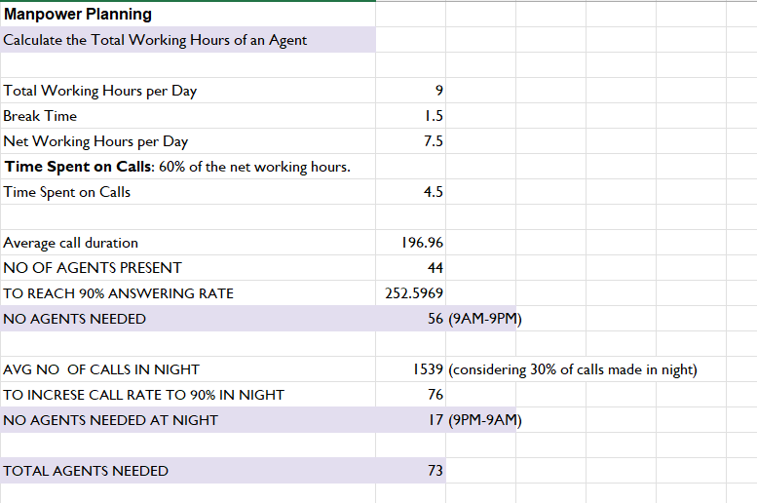
Manpower Planning:
What is the minimum number of agents required in each time bucket to reduce the abandon rate to 10%?
Calculation for no. of agents needed to increase efficiency

Slide 10
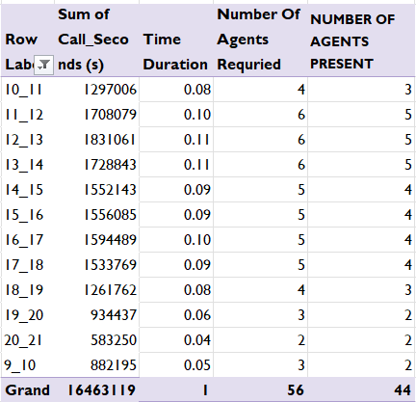
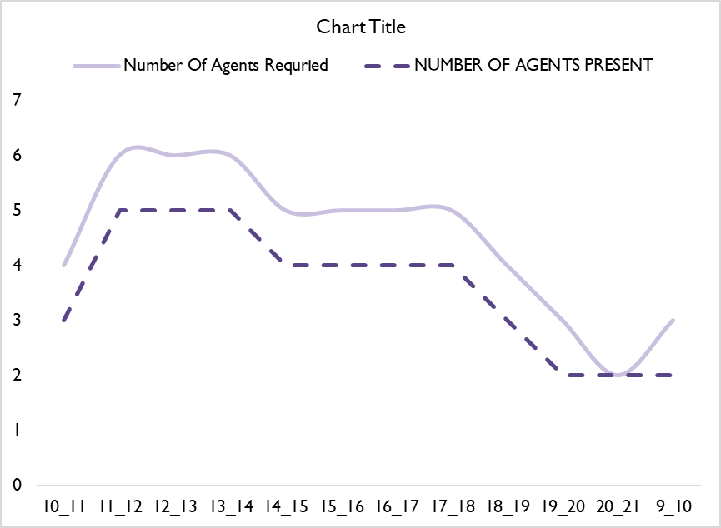
Pivot table for agent required in each time bucket
Line chart comparing agents present vs agents required

Slide 11
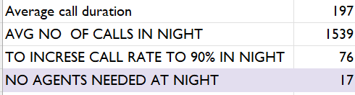
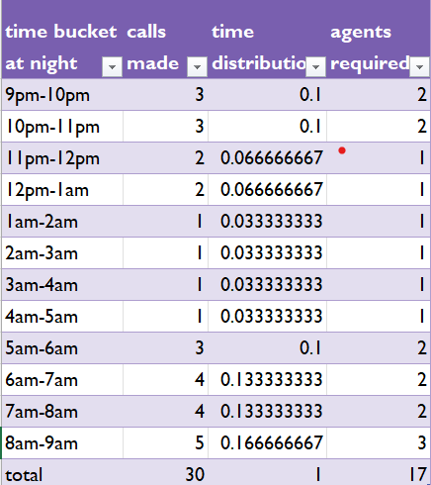
Night Shift Manpower Planning
Propose a manpower plan for each time bucket throughout the day, keeping the maximum abandon rate at 10%.
Considering 30% calls are made during night with 10% abandonment rate the total number of agents required are 17. These agents are distributed accordingly into time buckets

Slide 12
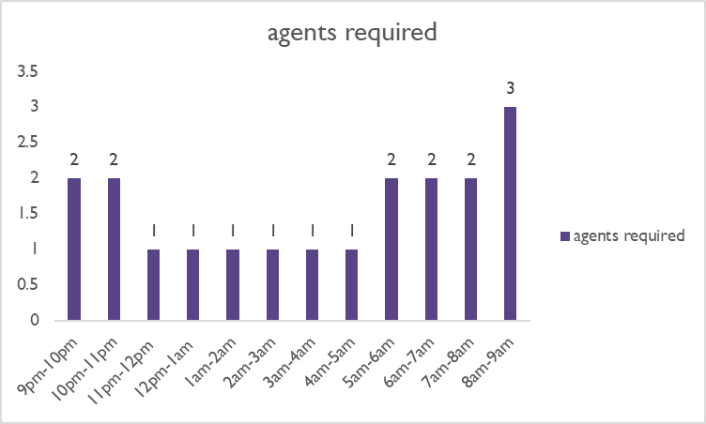
Distribution of agents in time Buckets for night shift.

Slide 13
INSIGHTS
The highest average call duration is 22:54:17 at the time bucket 14_15.
The highest percentage of customer call duration is 12.40% at time bucket 11_12 with 14626 calls.
The total manpower need to reach 10% abandonment rate is 56 in the morning shift
Manpower needed at night considering 30% of the calls are made at night the total number of agents required would be 17.

Slide 14
THANK YOU
Excel: link

